Slide 1
Diagnosing errors in communication when designing remediation plans
C. Jessica Dine, MD MSHPR
ASH Training Program Directors’ Workshop
December 4, 2015

Slide 2
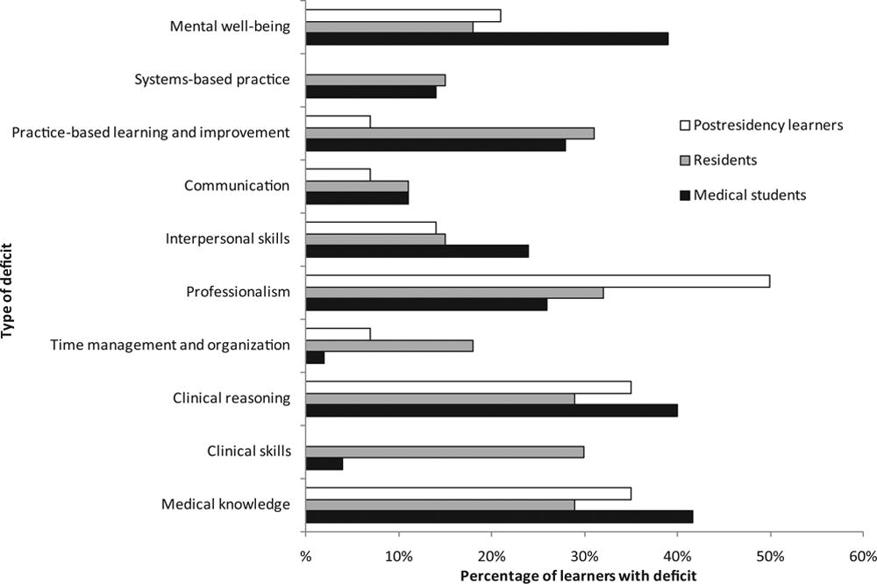
Remediation by Competency
Guerrasio. Academic Medicine. 2014.
Notes:
Most (almost 80%) had more than 1 competency issue

Slide 3
Hickson. Academic Medicine. 2007.

Slide 4
Differential Diagnosis
Psychosocial stress
Psychiatric diagnosis
  Depression
  Personality disorder
Impairment
Learning disability
Poor preparation
Wrong career (or program) choice

Slide 5
Coaching Plan for Millennials
Authority figures
  Who are you and why should they trust you
  Have proofs (assessment data)
Set goals
  Specific goals based on the data
  Ideally relevant to the learner
  Time-line for observation and reassessment
Be transparent
Frequent feedback
  Consider real-time access or real-time feedback

Slide 6
Remediation
Assessment
  Pre-interview assessment (include self-assessment)
  Interview
Deliberate practice
  List of deficiencies – be specific
  How will they be addressed
  Start with the most important deficiency first
Feedback
Reflection
Reassessment

Slide 7
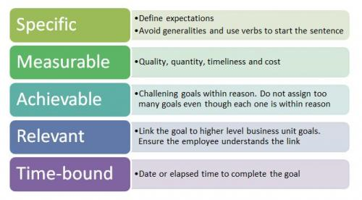
Coaching Plan
Notes:
The key is naming the steps and creating systems and frameworks for things we often take for granted
Think about it:
How do you admit a patient efficiently?
What are the components of pre-rounding?
How do you break down the generic contents of a care plan for a progress note?

Slide 8
Remediation Plan
List deficiencies
  List relevant specific tasks involved in the competency
  Determine if they are observable
  Determine if they are measurable
Identify faculty mentors
  Determine who will observe the trainee
  Determine who will meet with the trainee
    Consider an observer and a “coach”
Time line

Slide 9
Case 1
Tim is a first year fellow. He graduated from a residency program across the country with high recommendations from everyone.
You received an email from a faculty member that Tim disagreed with the attending about a management decision and became argumentative.
You pull his evaluations so far. There are several comments about Tim being dismissive of nursing comments and Tim not being receptive to feedback. His medical knowledge seems to be below average based on comments.

Slide 10
Case 1
Tim arrives for his scheduled meeting with you that you set up to review this with him.
He laughs about these complaints and states
  “totally taken out of context”
  “the culture at my previous institution was different – I’m used to speaking my mind”

Slide 11
Case 1
Deficiencies | Specific related tasks | Observable | Measurable
 |  | Yes/No | Yes/No
 |  | Yes/No | Yes/No
 |  | Yes/No | Yes/No
 |  | Yes/No | Yes/No
Plan:
Observers:
Coaches:
Timeline:
How do you get buy-in from Tim?

Slide 12
Case 2
Alice has been participating well at conference and her medical knowledge is excellent. There have been several complaints that Alice will often “play” on her smartphone during rounds.
Alice states that she is pulling up relevant articles during rounds most of the time. Every once in a while she checks email when she feels that she has nothing to add to the conversation.
She stops using her phone during rounds but then you see her texting during the next conference including a program director’s breakfast.

Slide 13
Case 2
Deficiencies | Specific related tasks | Observable | Measurable
 |  | Yes/No | Yes/No
 |  | Yes/No | Yes/No
 |  | Yes/No | Yes/No
 |  | Yes/No | Yes/No
Plan:
Observers:
Coaches:
Timeline:
What should a policy about using smartphones or tablets while at work say?

Slide 14
Case 3
Frank is a second year fellow. He did very well during his first year without any deficiencies identified. You asked him to come into the office because you received an email from one of the faculty members that Frank fell asleep during a clinic patient encounter. When the faculty member asked Frank about it, Frank apologized and said it would never happen again. However, he would not elaborate further.
Frank comes into the office and tells you that he “just had a bad night” and “didn’t sleep well”.
A week later, you receive a phone call that he appears tired and “not himself”.

Slide 15
Case 3
Deficiencies | Specific related tasks | Observable | Measurable
 |  | Yes/No | Yes/No
 |  | Yes/No | Yes/No
 |  | Yes/No | Yes/No
 |  | Yes/No | Yes/No
Plan:
Observers:
Coaches:
Timeline:
What would you do at this point?

